Slide 1
The Rover’s hardware and software
Wilbert Alberts

Slide 2
Content
Rover hardware
Sensors and actuators
Computing platform
Communication Pi - Arduino
Processing encoder inputs
Reading IR sensors
Line-tracking Rover Software
Rover SW
The API
The application
Development environment (so far)

Slide 3
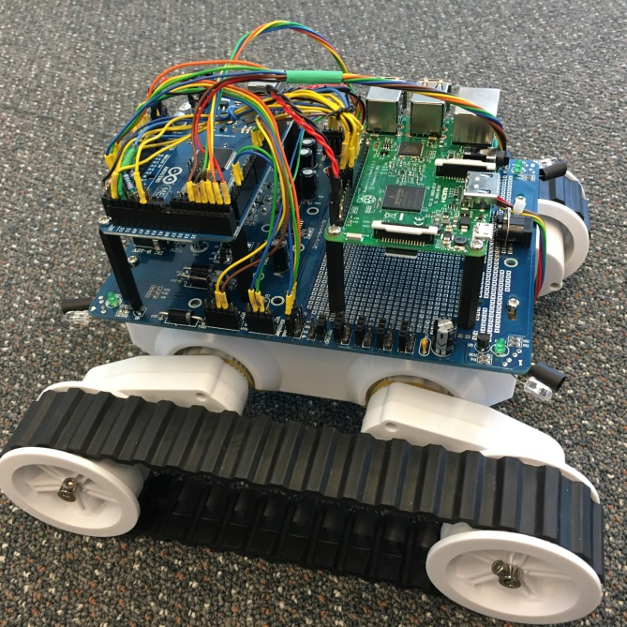
System hardware
Chassis
Two tracks
Two motors
Two quadrature encoders
Power supply
IR Sensors
IR Lights
Collision
Line

Slide 4
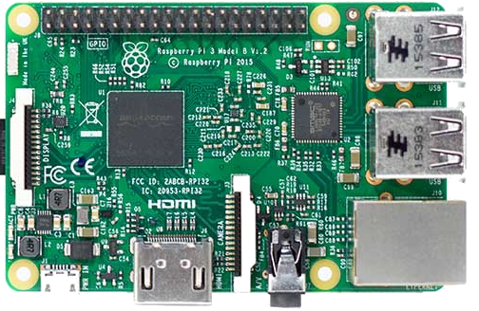
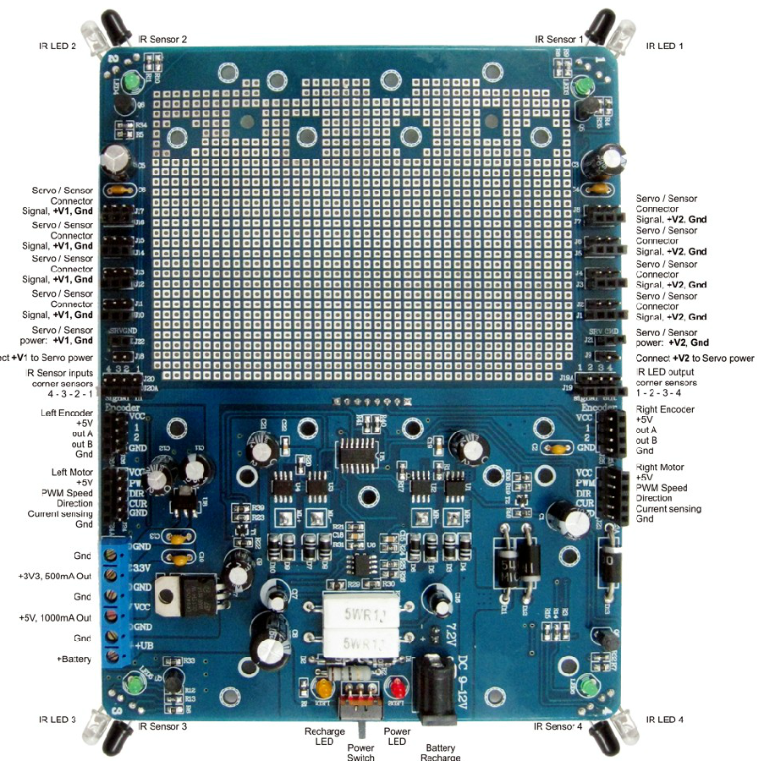
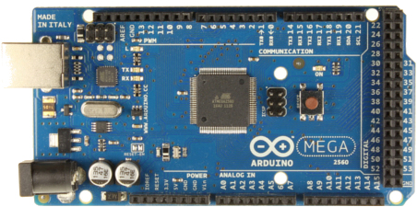
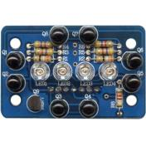
System hardware
SPI
ReqExc
AckExc
Motor direction L/R
Motor dutycycle L/R
Encoder AB L/R
Line Sensor (4x)
Collision sensor (4x)
Line light
Collision light (4x)

Slide 5
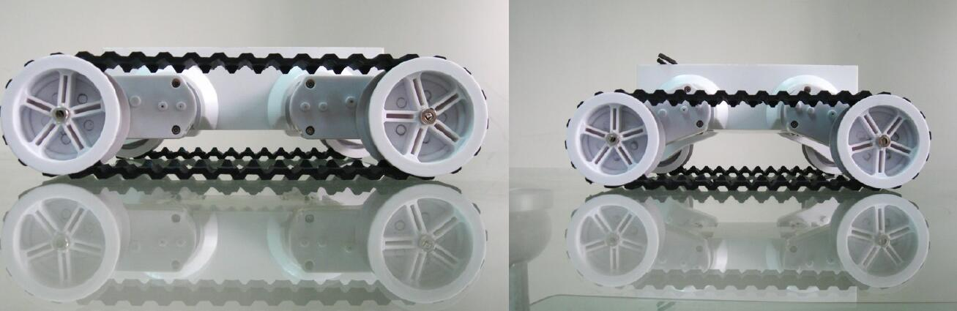
System hardware
Chassis
Height w.r.t. ground level can be adjusted by changing the angles of the ‘legs’ of the robot
Also affects tension of the tracks

Slide 6
Sensors and actuators
Motors
The chassis houses two motors
Motors are driven by motor circuits that transforms a PWM signal into voltage that is supplied to motors
Relation between pulse width and torque depends on motor characteristics and supply power.
Motor characteristics likely differ and supplied power changes when running on batteries
Consequence: don’t expect same torque when applying identical pulse width to left and right

Slide 7
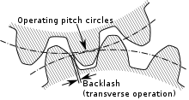
Sensors and actuators
Wheels and tracks
Motors drive wheels via a gearbox
Expect backlash in gearbox cogs
Implication: when changing motor direction, cogs have to adjust before change is effectuated on wheels
Wheels move tracks
Tracks provide teeth in order to avoid slip w.r.t. wheels but the wheels don’t exploit that
Friction resulting from materials and track tension should avoid most of the slip between wheels and tracks

Slide 8
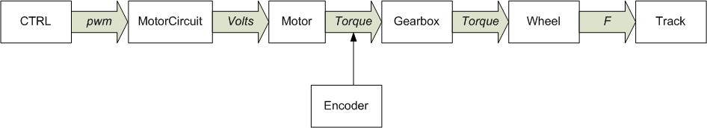
Sensors and actuators
Wheels, encoders and Rover position
Both wheels contain a quadrature encoder
Gearbox is after the encoder
Encoder measures rotation position of axis entering gearbox
Any error ‘behind’ the encoder is not detectable while determining the Rover’s position
Backlash in gearbox
Slip between wheel and track
Slip between track and ground
Wheel dimension needs to be taken into account in order to transform rotation increments into horizontal displacement

Slide 9

Sensors and actuators
Rover’s position
Certain things we do know:
When wheels don’t rotate, Rover doesn’t move
When wheels have travelled equal distance, Rover will have moved the same distance in a straight line
Assuming no slip
When wheels have travelled a different distance, Rover will have made a turn and tracks will have slipped w.r.t. ground
But I don’t have any idea how ☺

Slide 10
Sensors and actuators
The Rover requires power for the Arduino, the Pi and the motors
Input power is 12V which is distributed to motors and transformed down to 5V for sensors and computers.
Chassis supports batteries but this has not been tested
Power supply via wall wart is a self developed addition
Power consumption can be rather high
We noted drop outs when changing from 0% to 100% pwm in one go

Slide 11
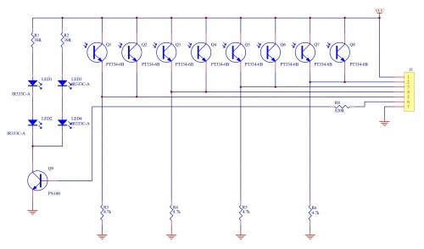
Sensors and actuators
Collision/Line sensors
Same technology: IR sensors
Combined with IR lights for contrast
Shrink wrap used to improve directionality
Collision sensors on corners (accompanied by a controllable light per corner)
Tracking sensors layout
Note 2 sensors are combined and added into one input
Note 1 output controls all lights

Slide 12
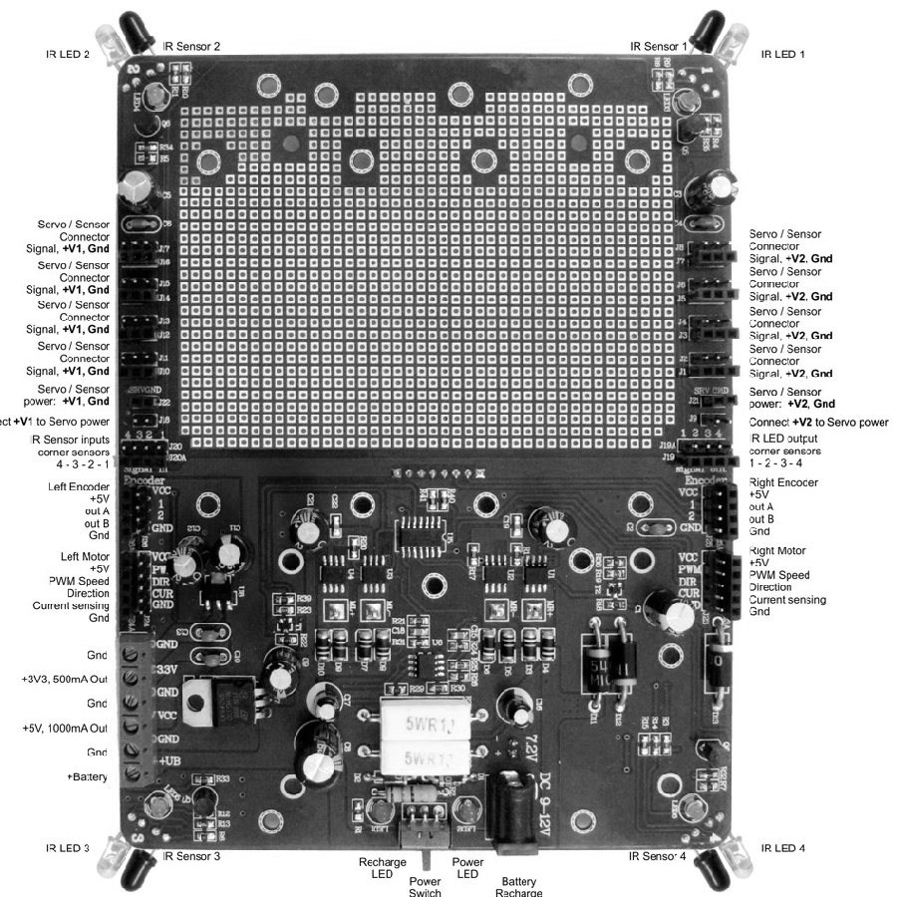
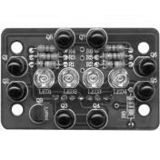
Computing platform
Computing is distributed over a Pi and an Arduino based board
SPI
ReqExc
AckExc
Motor direction L/R
Motor dutycycle L/R
Encoder AB L/R
Line Sensor (4x)
Collision sensor (4x)
Line light
Collision light (4x)

Slide 13
Computing platform
Computing is distributed over a Pi and an Arduino based board
Pi: main application
Arduino: pwm generation, sensor readout
Communication between Pi and Arduino is done by SPI
Pi: raspberry Pi3, standard Raspbian distribution
Arduino: mega avr 2560 @ 16 Mhz
Rationale for Arduino:
Pi has limited PWM generation facilities and limited IO inputs

Slide 14
Computing platform
Arduino inputs
4 IR collision sensors (analogue)
4 IR tracking sensors (analogue)
1 SPI request transfer
1 SPI clock
1 SPI data
1 SPI chip enable
2 AB left (quadrature)
2 AB right (quadrature)
Arduino outputs
1 IR tracking light
4 IR collision lights
2 motor PWM
2 motor direction
Pi inputs
1 SPI data
1 SPI ack transfer
Pi outputs
1 SPI data
1 SPI clock
1 SPI req transfer
1 SPI chip enable

Slide 15
Computing platform
Arduino inputs
4 IR collision sensors (analogue)
4 IR tracking sensors (analogue)
1 SPI request transfer
1 SPI clock
1 SPI data
1 SPI chip enable
2 AB left (quadrature)
2 AB right (quadrature)
Arduino outputs
1 IR tracking light
4 IR collision lights
2 motor PWM
2 motor direction
1 SPI ack transfer
Pi inputs
1 SPI data
1 SPI ack transfer
Pi outputs
1 SPI data
1 SPI clock
1 SPI req transfer
1 SPI chip enable
These signals would have to be handled
by Pi if Arduino wasn’t used.

Slide 16
Communication between Pi and Arduino
Goal
to send sensor input from Arduino to Pi and to motor outputs from Pi to Arduino

Slide 17
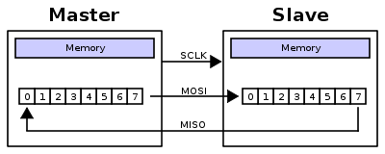
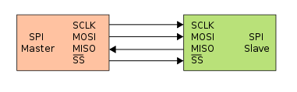
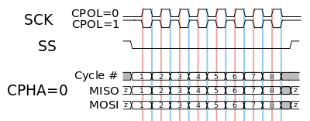
SPIchology
Facilitates communication between master and slave
Conceptually: master and slave exchange bytes
See also: https://en.wikipedia.org/wiki/Serial_Peripheral_Interface_Bus

Slide 18

Communication between Pi and Arduino
Goal
to send sensor input from Arduino to Pi and to motor outputs from Pi to Arduino
Back of a napkin
Assumption: Arduino won’t do event detection, consequence: Pi has to poll
Assumption: Arduino does translate quadrature inputs to position
Assumption: Position are expressed in longs (4 bytes per wheel)
Assumption: Per IR sensor two signals are delivered: with/without IR illumination (two bytes per signal, 4 bytes per sensor)
Total of 40 bytes from Arduino to Pi and 4 bytes from Pi to Arduino
SPI speed set to 4Mhz
4 million bits / second = 0.5MB/s = 0.5kB/ms = 0.5 B/us = 2us / B
44 bytes is 88 us
2*4=8
8*2*2 = 32 +
40

Slide 19
Communication between Pi and Arduino
44 bytes, communicated in 88us
However…
We add a header and trailer in order to detect and verify message (2*4 bytes)
We add two timestamps generated by Arduino for diagnostics (2*4 bytes)
Message increases to 60 bytes so 120 us
Still reasonable

Slide 20
Communication between Pi and Arduino
60 bytes sent 120us
However…
While the current byte is send:
The next one needs to be put in the transmit buffer
The pointer to the next byte to be written needs to be incremented
The previous byte needs to be saved
The pointer to the next byte to be saved needs to be incremented
A test is needed to check whether the last byte has been received
Receival is triggered by interrupt, so registers need to be saved and restored
SPI at 4 Mhz results in 2 us per byte, maybe a little bit more
Arduino at 16 Mhz results in 16 instructions per us:
32 us per SPI byte transfer

Slide 21
Communication between Pi and Arduino
Only 32 instructions per byte, that’s impossible
Solution: add delay between sending each byte by Pi order of 10 us
60 bytes, 10 us/byte : 600 us
Inspection with logic analyzer showed that Pi added additional overhead before sending first byte
Final result: somewhat over 1 ms for sending message.
(Note: when running a control loop at 100 Hz, servo period < 10ms, we just wasted 1 ms on communication only!)

Slide 22
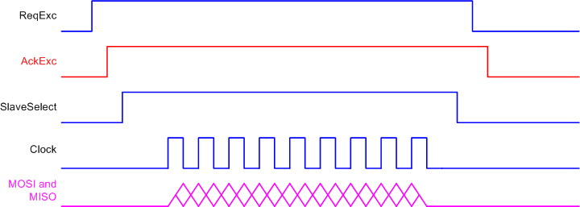
Communication between Pi and Arduino
Communication is controlled by Pi via a handshake:
Pi makes ReqExc high and waits for the Arduino to react
Arduino gets data from registermap and makes AckExc high
Pi starts SPI transfer
Pi and Arduino exchange byte by byte until all has been transferred
Pi lowers ReqExc and waits for the Arduino to react
Arduino lowers AckExc and updates data in register map
Pi concludes that communication has succeeded

Slide 23
Communication between Pi and Arduino
MMDC – man machine damage control
What if application crashes while rover is moving?
What if communication fails or data gets mangled?
MMDC in Arduino should monitor communication with Pi. If no communication has taken place since 0.5 second, Rover should stop
Implemented in SW, unreliable by nature, at least we’re not doing a nuclear power plant

Slide 24
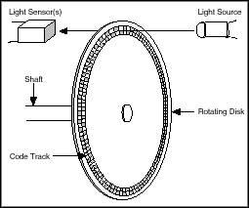
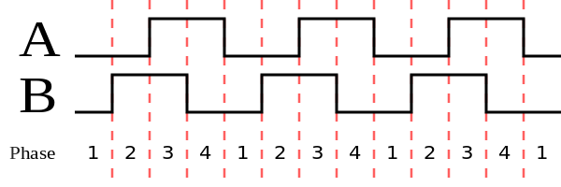
Processing quadrature sensor
Position is determined by monitoring changes in A and B, translate them into phase transitions and relate phase transition to position increment or decrement
See also: https://en.wikipedia.org/wiki/Rotary_encoder#Incremental_rotary_encoder

Slide 25
Processing quadrature decoding
Important: your processor needs to be able to handle the transitions in time
Nr of transitions per second is determined by rotation speed and number of marks per revolution.
Back of a napkin:
Expected speed: 1km/h, 277mm/s
Wheel diameter 60mm, periphery 188mm
Consequence: 1.47 revolution per second
250 marks per 3 revolutions (gearbox),
1000 transitions per 3 revolutions,
333 transitions per revolution
Consequence: 491 transition per second, ~5 transition per ms, ~200 us per transition

Slide 26
Processing quadrature encoding
200 us per transition
As communication takes ~1ms, we need to interleave communication with quadrature decoding
Solution: use interrupt service routine (on Arduino input port changes) to react on encoder pulses
Reaction consists of testing current state, increment or decrement position and change to new state, guestimate: 25 instructions ~ 2 us / transition
Assume servo period of 100 Hz, 10 ms/period, 50 transitions per period, 100 us per period.

Slide 27
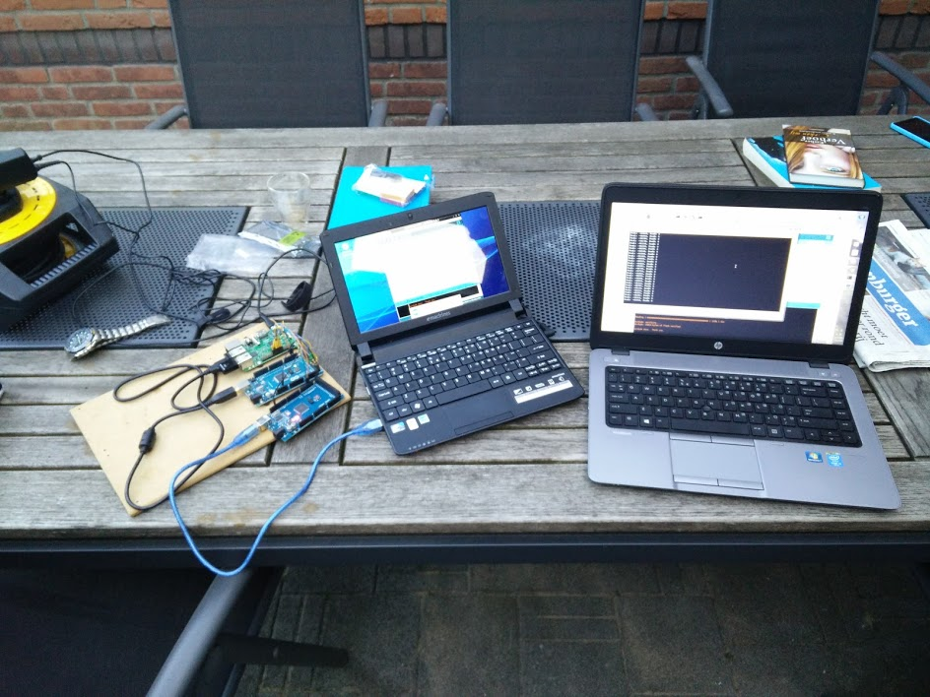
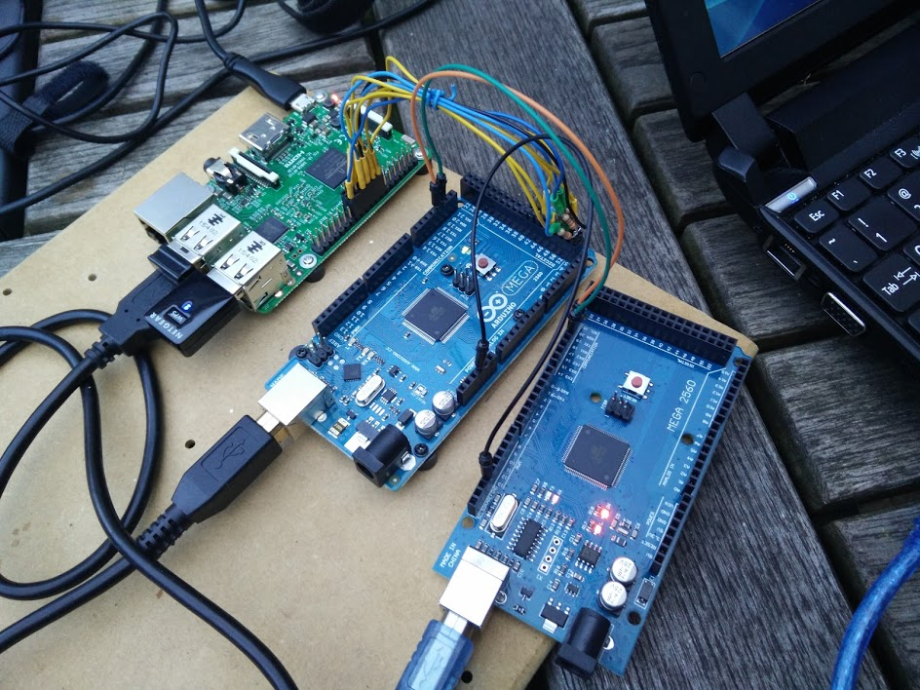
Processing quadrature encoding
Testbench:
use second arduino to generate quadrature signals to verify ability of keeping up at maximum speed

Slide 28
Reading IR sensors
IR sensor detects infrared light
Note, IR light is always present, ambient light
Professional solution:
Modulate IR light with a certain frequency (pwm)
Add notch filter, tuned at same frequency, after IR sensor
Output of notch filter corresponds with reflected (non ambient) light
Poor mans solution:
Turn off IR light
Measure ambient
Turn on IR light
Measure reflected light
Subtract ambient from reflected

Slide 29
Reading IR sensors
Poor mans solution:
Turn off IR light – wait 50us
Measure ambient – 100 us
Turn on IR light – wait 50us
Measure reflected light – 100 us
Subtract ambient from reflected - neglible
Duration per sensor: 300us, sensors have to be read consecutively.
4 collision sensors: 1.2,ms
Linetracking sensors share IR light diode, allows for small optimization
4 linetracking sensors, 8 readings, 2 wait’s: 0.9 ms
Total: 1.2+0.9 equals 2.1 ms.

Slide 30
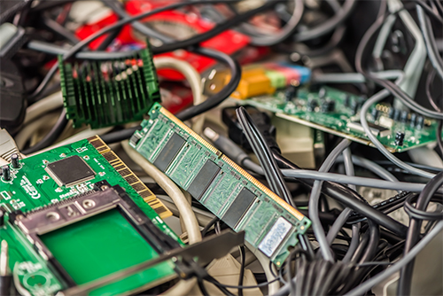
Sensors and actuators
Timing analyisis, what needs to be done (per period):
Sensor readout: 2.1 ms
Communication: 1 ms
Quadrature decoding: 0.1 ms (100us)
Total: 3.2 ms
With the assumption of 10 ms per servo period, this seems reasonable.
Lessons learned (from previous hobby project): if you don’t do these analysis upfront, you’ll end up with a lot of unusable stuff in your stock

Slide 31
The Rover SW
The SW consists of:
An application running on the Arduino
A library facilitating HW manipulation on the Pi
An application implementing the linetracking on the Pi
An application calibrating the linesensors on the Pi

Slide 32
The Arduino Application
Arduino provides an IDE and an execution environment allowing easy programming on AVR microcontrollers (and others)
https://www.arduino.cc/
An Arduino application typically consists of:
a setup function (called once)
a loop function (called repetitively as fast as possible)
The Arduino application consists of a number of modules
Each module contains a setup and a loop
The module’s setup and loop and called by the main setup and loop

Slide 33
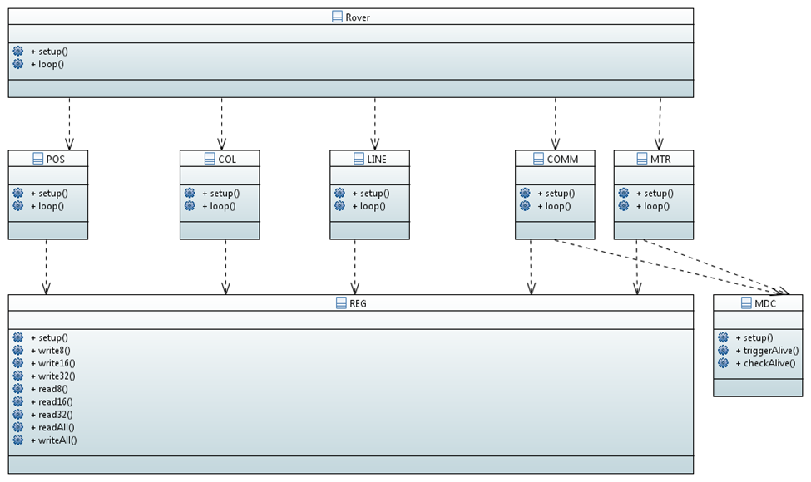
The Arduino Application
The following modules have been implemented:
Rover (main setup and loop)
POS (translating AB encoder pulses into positions)
COL (reading collision sensors)
LINE (readling line sensors)
MTR (controlling motor PWM and direction)
COMM (implementing communication)
MDC (machine safety)
REG (register map implementation)
POS, COL, LINE read sensors and write the values in the corresponding REG registers
MTR reads the REG register and applies it to the hardware
COMM updates the REG registers by exchanging the content with the Pi

Slide 34
The Arduino application
Most modules are very simple, just manipulating IO ports and ADC’s
More complex parts: COMM and MDC
(Slightly more) documentation can be found in Design.doc

Slide 35
The Pi library
Goal: to provide a library that allows applications maximum freedom of usages
Approach:
By invocation of an initialize function, the library spawns a thread that iteratively exchanges data with the Arduino – this realizes the sample loop
The exchanged register map is locally stored
The API provides means to read the most recent data from the local copy of the registermap
Additionally:
The library provides means to dump the most recent results of the data exchange to file for analysis.

Slide 36
The Pi API
extern int RV_loopLoggingOn();
extern int RV_loopLoggingOff();
extern int RV_loggingOn();
extern int RV_loggingOff();
extern int RV_start();
extern int RV_setFrequency(int herz);
extern int RV_stop();
extern int RV_waitForNewData();
extern int RV_getPosition(long* leftPos, long* rightPos);
extern int RV_move(int leftDirection, int rightDirection, int leftDC, int rightDC);
extern int RV_getLineSensors(RV_LineSensors* lineSensors);
extern int RV_getCollisionSensors(RV_CollisionSensors* collisionSensors);
extern int RV_getAVRTime(long* millis, long* micros);
extern int RV_dumpBuffersToFile(const char* name);
extern int RV_addTraceVariable(const char* name, double* var);
More documentation in rv.h

Slide 37
The Pi API
A number of operations simply read/write information in the registermap
The more complex part involve
The communication with the AVR
Guarding concurrent access to registermap (user thread and library thread)
Synchronization mechanism to keep user thread and library thread in lock step

Slide 38
The Pi Application
A typical Pi application will look like:

Slide 39
The Pi Application
WaitForNewData keeps application in sync with library’s communication thread
If duration of application body exceeds servo period, communication of the library thread is not blocked. So the application might have to wait for the library task, but the library task will never by blocked by the application.
(Required some fiddling with semaphores)

Slide 40
The actual Line tracker application
#include "rv.h"
int main (int argc, char* argv[])
{
bool ready = false;
RV_setFrequency(100);
RV_start();
while (not ready)
RV_waitForNewData();
sensors.process();
controller.process();
actuators.process();
if (mustStop())
break;
}
RV_stop();
}

Slide 41
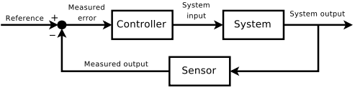
The actual Line tracker application
Actually, a form of feedback control loop implementation
Feedback control loop:
minimize the difference between the actual value of the property to be controlled its desired value
Implementation
Define the property you want to control
Define the desired value of this property
Repeat:
Readout sensors and translate into actual value of the controlled property
Determine difference between actual and desired value (error signal)
Perform calculation using error signal as input resulting in new settings for the controllable actuators.
#include "rv.h"
int main (int argc, char* argv[])
{
bool ready = false;
RV_setFrequency(100);
RV_start();
while (not ready)
RV_waitForNewData();
sensors.process();
controller.process();
actuators.process();
if (mustStop())
break;
}
RV_stop();
}

Slide 42
The actual Line tracker application
Controlled property: distance between line and line sensors
Sensors: line tracker sensors
Controllable actuators: pwm output for left and right tracks
Implementation:
Subtract output of east/west line sensors and use that as ‘distance’
Provide that to PID algorithm to determine left/right adjustment
Translate left/right adjustment in new settings for tracks and apply
#include "rv.h"
int main (int argc, char* argv[])
{
bool ready = false;
RV_setFrequency(100);
RV_start();
while (not ready)
RV_waitForNewData();
sensors.process();
controller.process();
actuators.process();
if (mustStop())
break;
}
RV_stop();
}

Slide 43
The actual Line tracker application
Two caveats:
Sensor input varies (noise)
PID control parameters
Sensor noise
Sensor noise is ‘high’ frequency noise (compared with expected changes)
Put low-pass filter between sensor output and PID algorithm
Control parameters
Study feedback control theory
Or trial and error (a lot of times)
#include "rv.h"
int main (int argc, char* argv[])
{
bool ready = false;
RV_setFrequency(100);
RV_start();
while (not ready)
RV_waitForNewData();
sensors.process();
controller.process();
actuators.process();
if (mustStop())
break;
}
RV_stop();
}

Slide 44
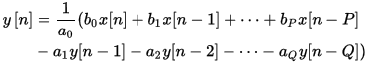
The actual Line tracker application
Noise filtering
Lot of theory available: https://en.wikipedia.org/wiki/Infinite_impulse_response
With y[n] being output (n represents time) and x[n] being input:
ai and bi being filter coefficients
Short form:
Used GNU Octave and signal package to create Butterworth IIR filter (i.e. determine ai and bi)
Experimented with cutoff frequency on obtained data until satisfied
Implement (generic) IIR in filter.cpp
#include "rv.h"
int main (int argc, char* argv[])
{
bool ready = false;
RV_setFrequency(100);
RV_start();
while (not ready)
RV_waitForNewData();
sensors.process();
controller.process();
actuators.process();
if (mustStop())
break;
}
RV_stop();
}

Slide 45
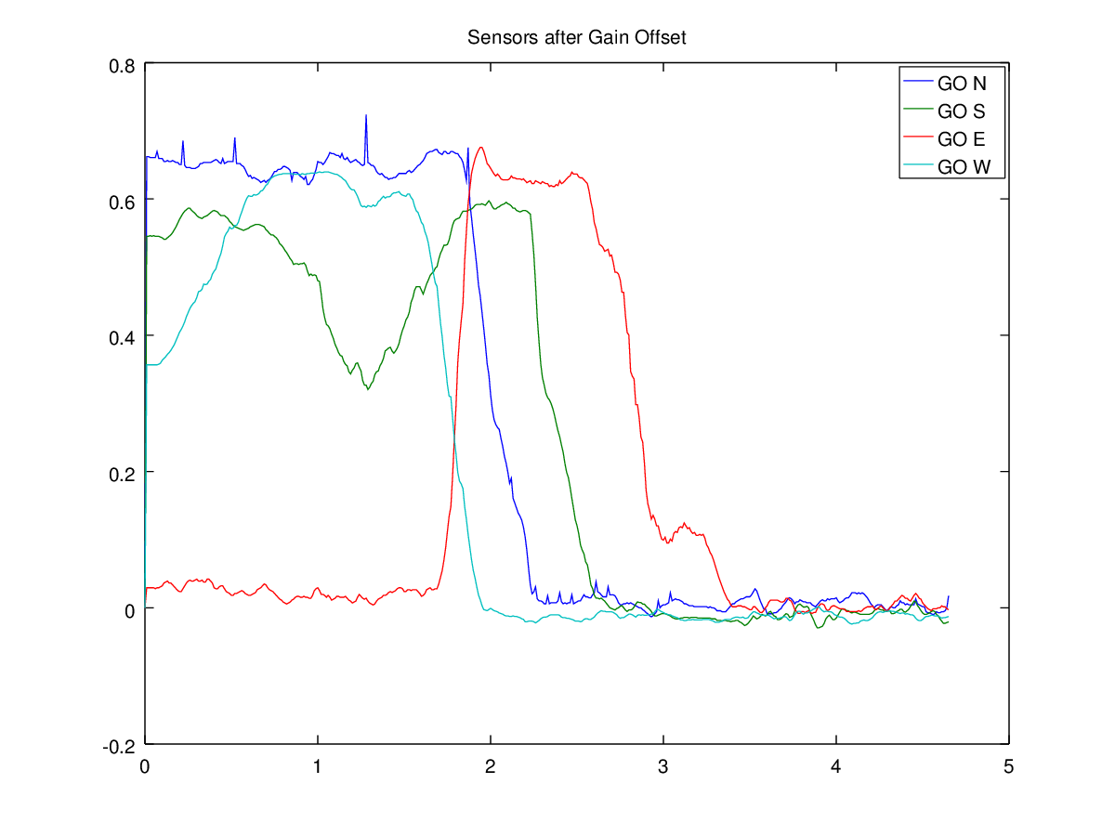
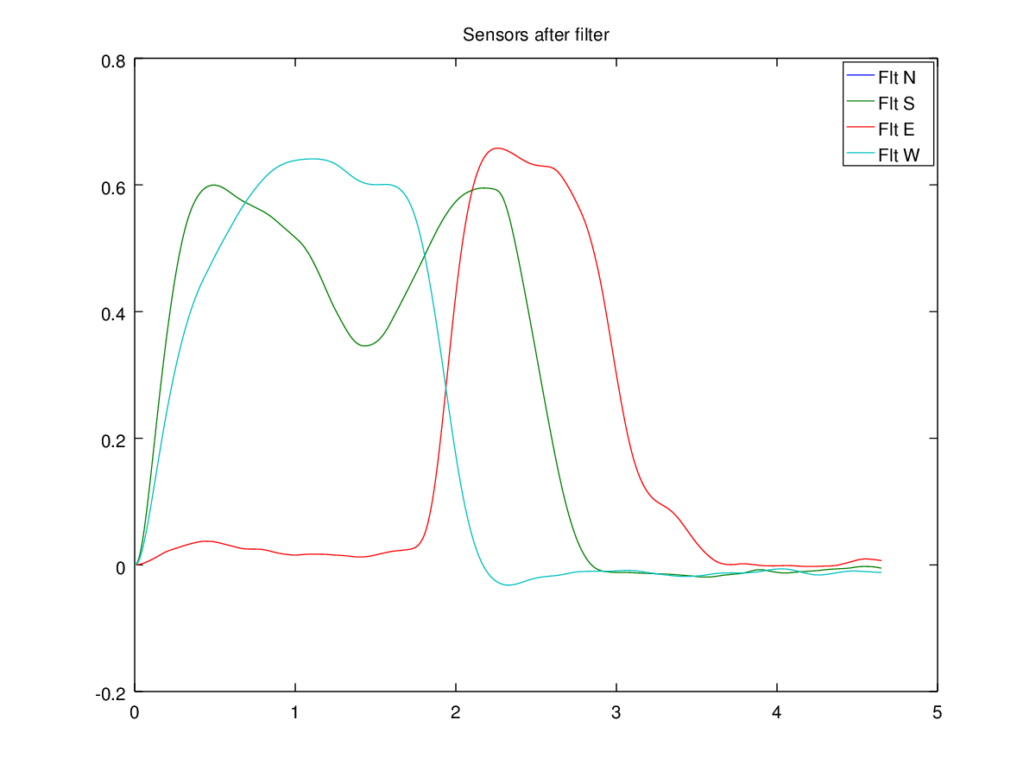
The actual Line tracker application
#include "rv.h"
int main (int argc, char* argv[])
{
bool ready = false;
RV_setFrequency(100);
RV_start();
while (not ready)
RV_waitForNewData();
sensors.process();
controller.process();
actuators.process();
if (mustStop())
break;
}
RV_stop();
}

Slide 46
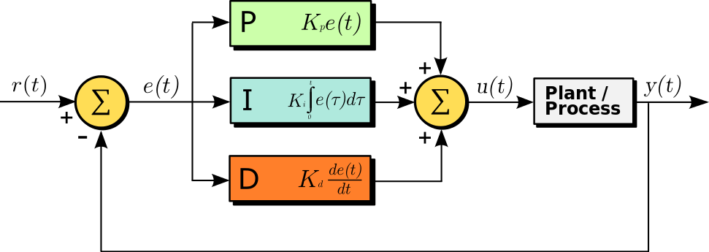
The actual Line tracker application
PID control
Lot of theory available: https://en.wikipedia.org/wiki/PID_controller#Modifications_to_the_PID_algorithm
P: react proportionally to error,
I: react on the integral of the error: ensures that steady state errors are corrected
D: react on the derivative of the error; has a damping effect
Implemented in pid.cpp
#include "rv.h"
int main (int argc, char* argv[])
{
bool ready = false;
RV_setFrequency(100);
RV_start();
while (not ready)
RV_waitForNewData();
sensors.process();
controller.process();
actuators.process();
if (mustStop())
break;
}
RV_stop();
}

Slide 47
The actual Line tracker application
So we have a controller output:
Output indicates whether we should move more to the right or to the left
How to translate this to motor outputs?
We want to go forward:
constant offset/velocity (cv)
We want to more left or more right:
distribute controller output over left and right motor (+cout and –cout)
Result:
Left = cv + cout
Right = cv - cout
#include "rv.h"
int main (int argc, char* argv[])
{
bool ready = false;
RV_setFrequency(100);
RV_start();
while (not ready)
RV_waitForNewData();
sensors.process();
controller.process();
actuators.process();
if (mustStop())
break;
}
RV_stop();
}

Slide 48
The actual Line tracker application
Result:
Left = cv + cout
Right = cv – cout
Requires translation in pwm dutycycle and direction:
Dutycyle = abs(o)
Direction = o < 0 ? Backward : Forward
Implemented in actuator.cpp
#include "rv.h"
int main (int argc, char* argv[])
{
bool ready = false;
RV_setFrequency(100);
RV_start();
while (not ready)
RV_waitForNewData();
sensors.process();
controller.process();
actuators.process();
if (mustStop())
break;
}
RV_stop();
}

Slide 49
The actual Line tracker application
Diagnostics:
The Rover library provides means to write most recent registermaps to file
The Rover library provides means to define additional variables that need to be traced
Trace file output puts variables in colums
Trace file output can be processed by excel, octave, matlab etc.

Slide 50
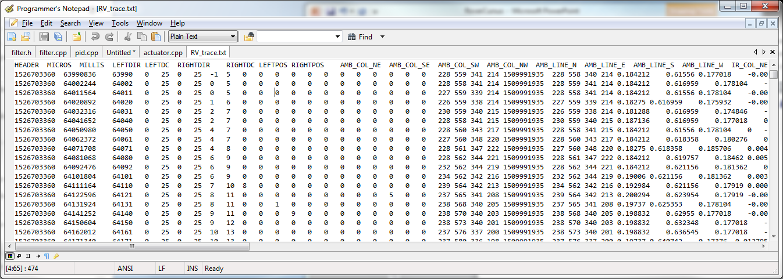
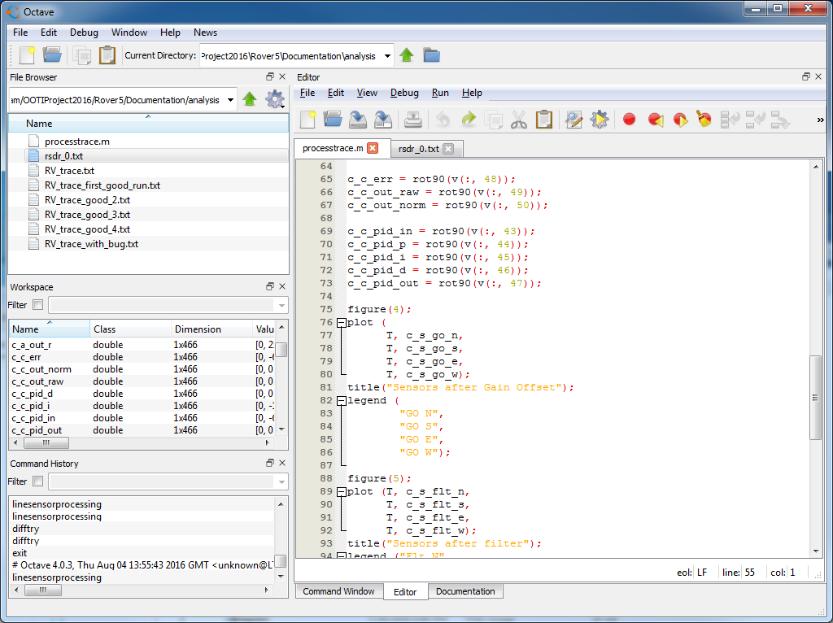
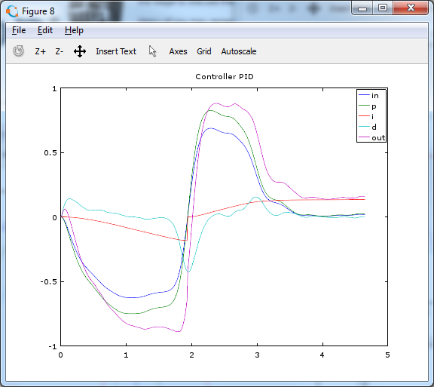
The actual Line tracker application
Diagnostics

Slide 51
Contrast calibration
Sensor Noise isn’t the only problem
4 Sensors, differences in sensor sensitivity (fabrication and shrink wrap effect)
Should be calibrated such that, given the same input, output is the same
Contrast between ground and line might vary (lighting condition, ground material, line material)
Can be calibrated with same calibration

Slide 52
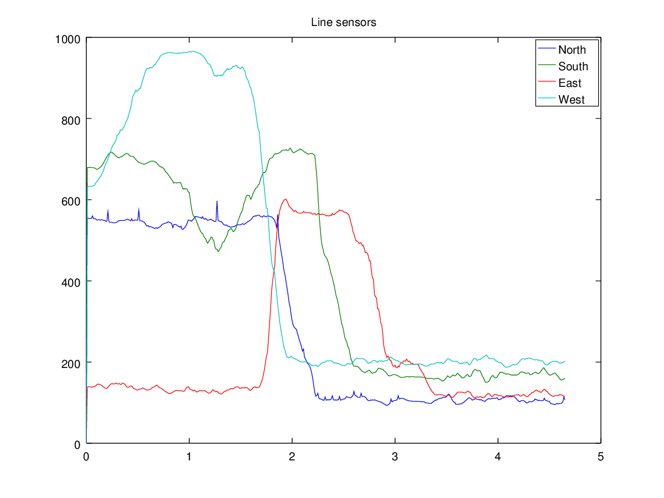
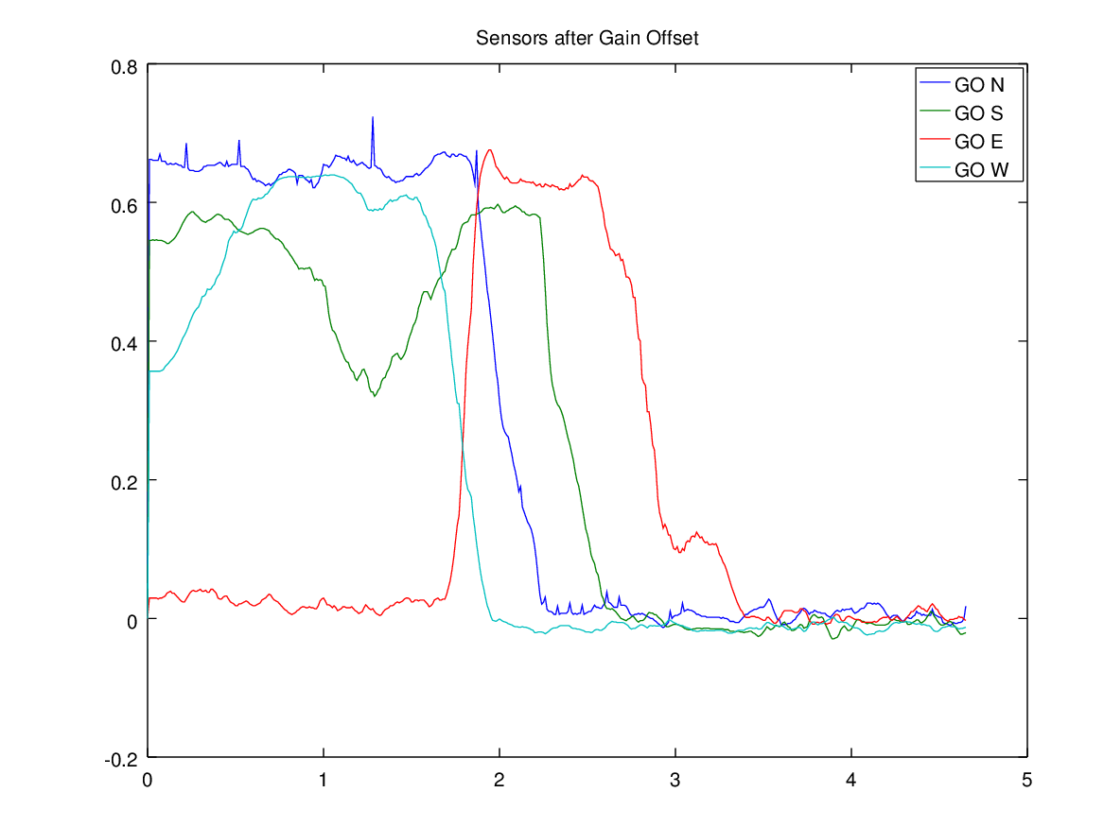
Contrast calibration

Slide 53
Contrast calibration
Strategy:
Move Rover to cross line in orthogonal direction
Capture trace data
Determine gain and offset such that each sensor reports 0 on minimum intensity and 1 on maximum intensity
Store gain and offset for use by line tracker algorithm
Apply gain and offset correction before filtering data.
So actual algorithm looks like
Raw sensor output
(i- offset)*gain
Filter()
PID
L = cv + v
R = cv - v
dcL = abs(L)
dirL = ….

Slide 54
Maze discovery
You didn’t really think that I would tell you the solution
Likely, your application will be in different modes (i.e. supervisory control):
Following the line, no junction detected
Junction detected, figure out directions
Remember junction, choose direction, come back later for the other one
And that’s all I’m gonna say

Slide 55
Development environment
Development environment is (mostly) up to you
But we used:
Eclipse for development of the Rover lib and application
C++ and makefiles generated by eclipse’s CDT
wiringPI library to interact with Pi’s hardware
Arduino for development of the Arduino part
Git and Github for configuration management
Octave for signal processing analysis and plotting

Slide 56

That’s all folks

